Slide 1
AIML PROJECT
AUTOMOBILE DATASET
MADE BY
AAYUSHMAN BHARDWAJ

Slide 2
CONTENTS
Dataset
01
dataset, missing values, descreption,
Visualization
02
Histograms, bar graphs, box plots, pair plot, heatmap
Regression
03
Linear regression, Polynomial regression, Logistic Regression
Classification
04
Decesion tree, navie bayes, KNN, SVM

Slide 3
01.
DATASET

Slide 4
About dataset
The dataset consist of data of cars produced by different automobile companies. it tells about the properties of cars like fuel type, aspiration, engine location, body type etc.
Input:'symboling','normalized-losses','fuel-type','num-of-doors','body-style','drive-wheels','enginelocation','length','width', 'height','engine-type','num-of-cylinders','engine-size','fuel-system','bore','stroke','compression-ratio','horsepower', 'peak-rpm','city-mpg','highway-mpg','make','price','curb-weight','wheel-base'

Slide 5
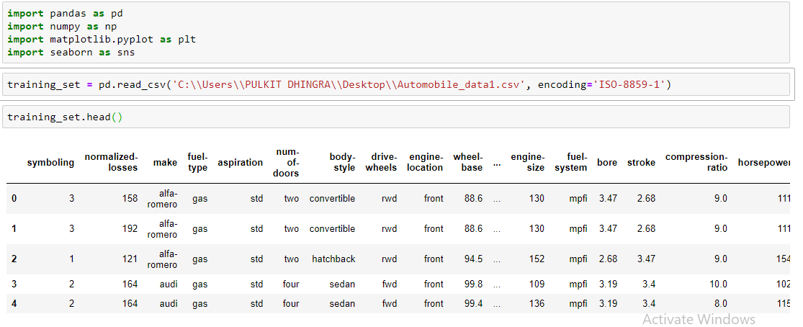
IMPORTING LIBRARIES AND LOADING DATASET
We imported various libraries so that we can work on our project. then we loaded our dataset

Slide 6
PREPARE DATASET FOR FURTHUR WORK
01 Enter subtitle
02 Enter subtitle
03 Enter subtitle
04 Enter subtitle
STEP 1
STEP 2
STEP 3
STEP 4
Replace '?'
Eliminate NAN
Final dataset
Total null value
My dataset has '?' instead of NAN. Replace '?' with 'NAN'.
Replacing null values with the mean of that column
Dataset without null values is prepared for furthur evaluation
Calculating total null values in dataset.

Slide 7
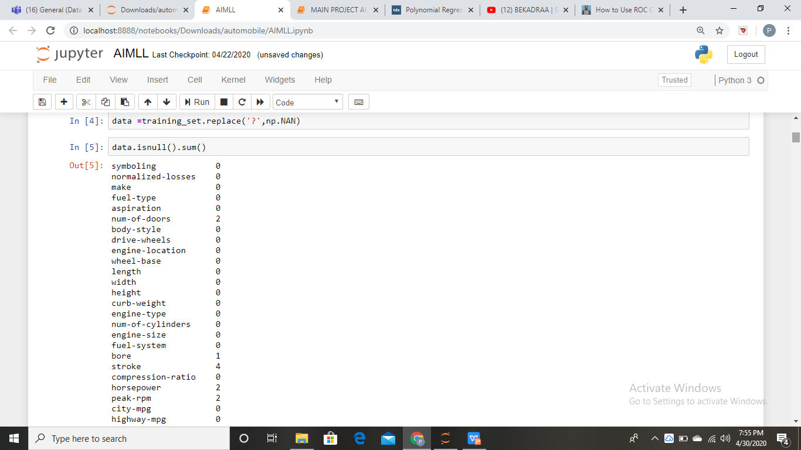
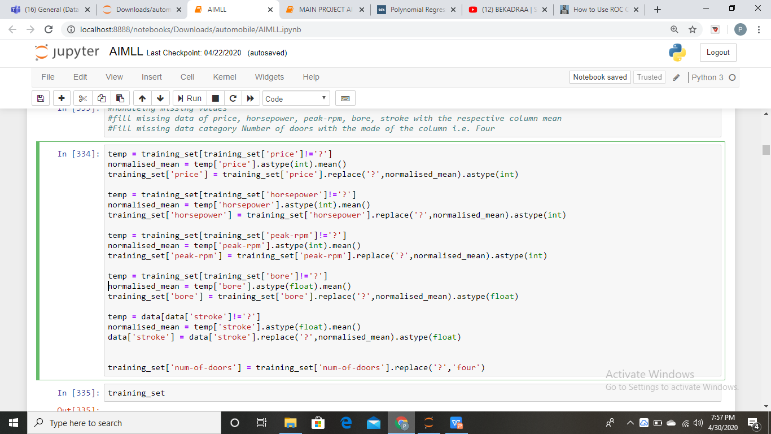
CODES

Slide 8
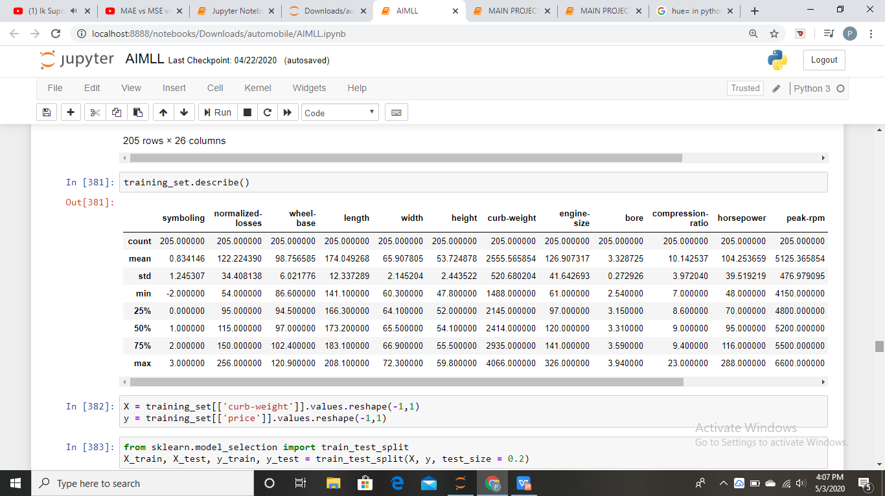
Dataset description
5 point summary of our dataset

Slide 9
02.
VISUALIZATION
Trying to know our dataset better

Slide 10
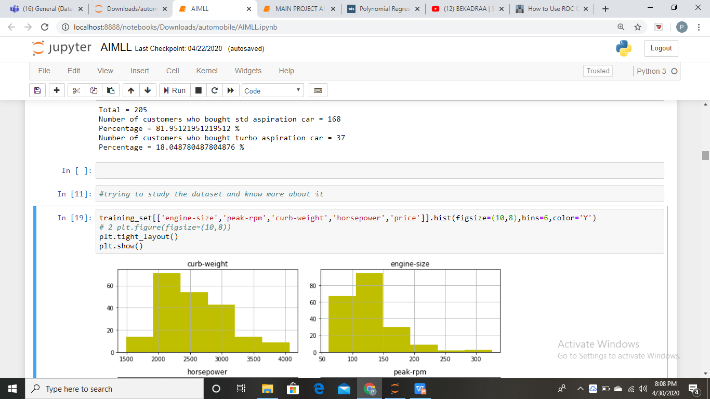
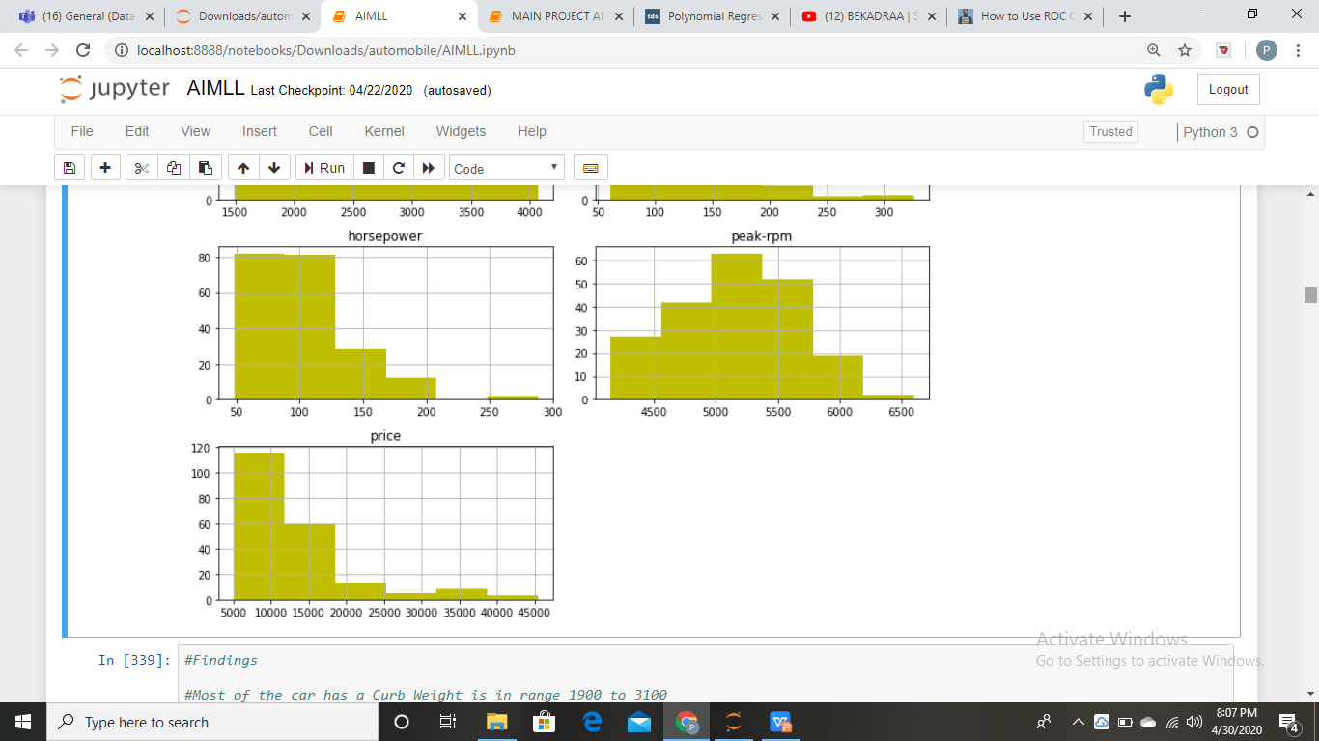
HISTOGRAMS

Slide 11
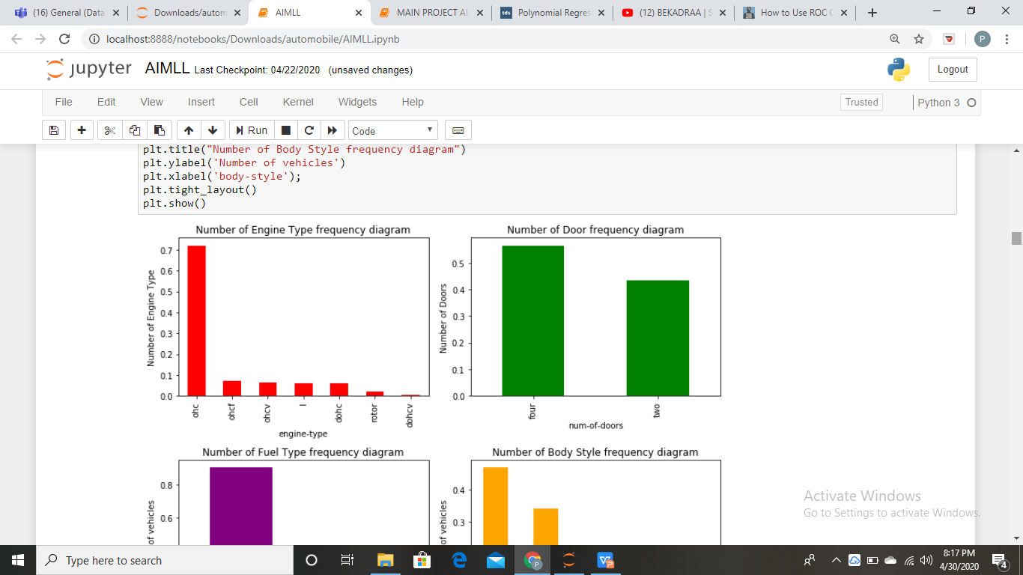
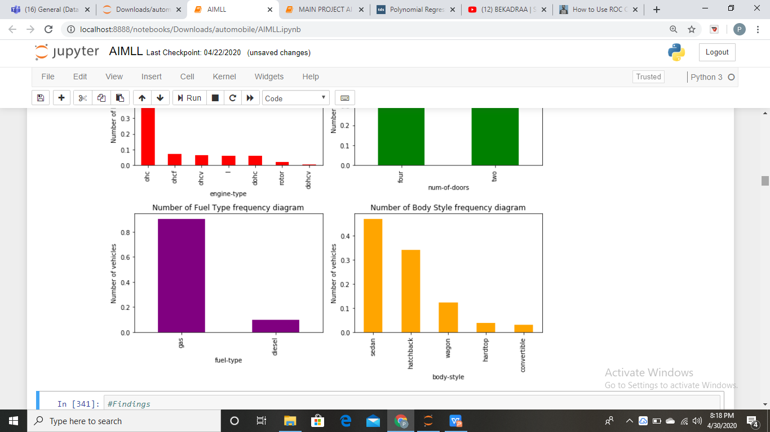
BARGRAPHS

Slide 12
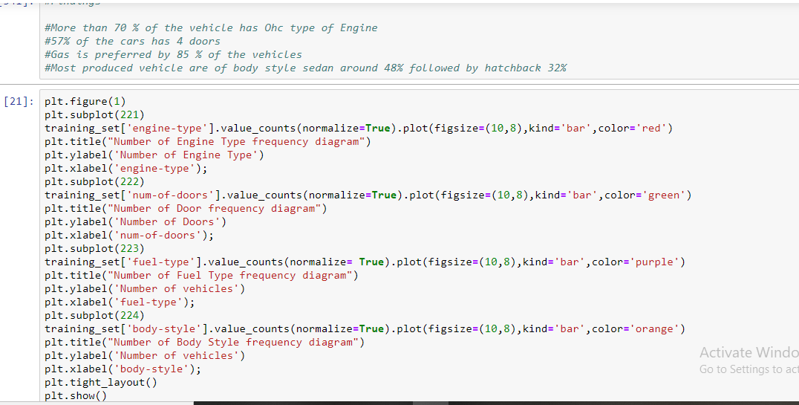

Slide 13
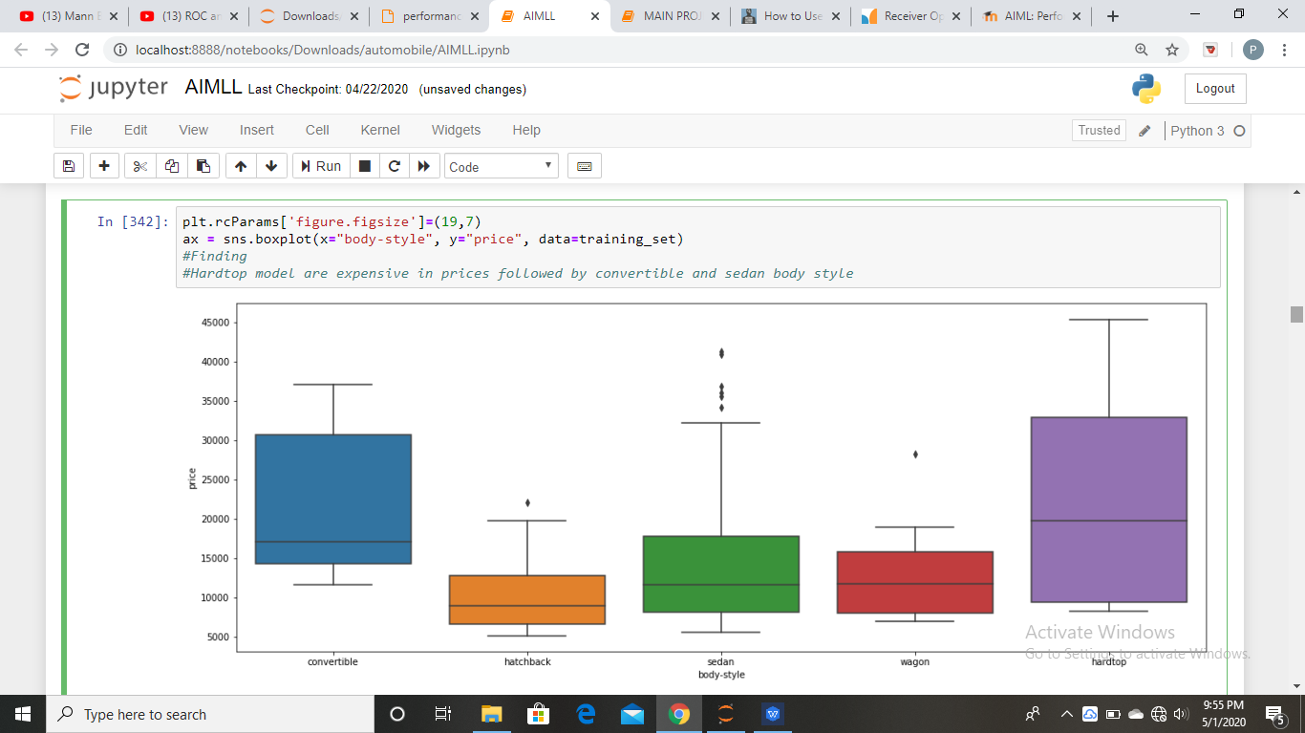
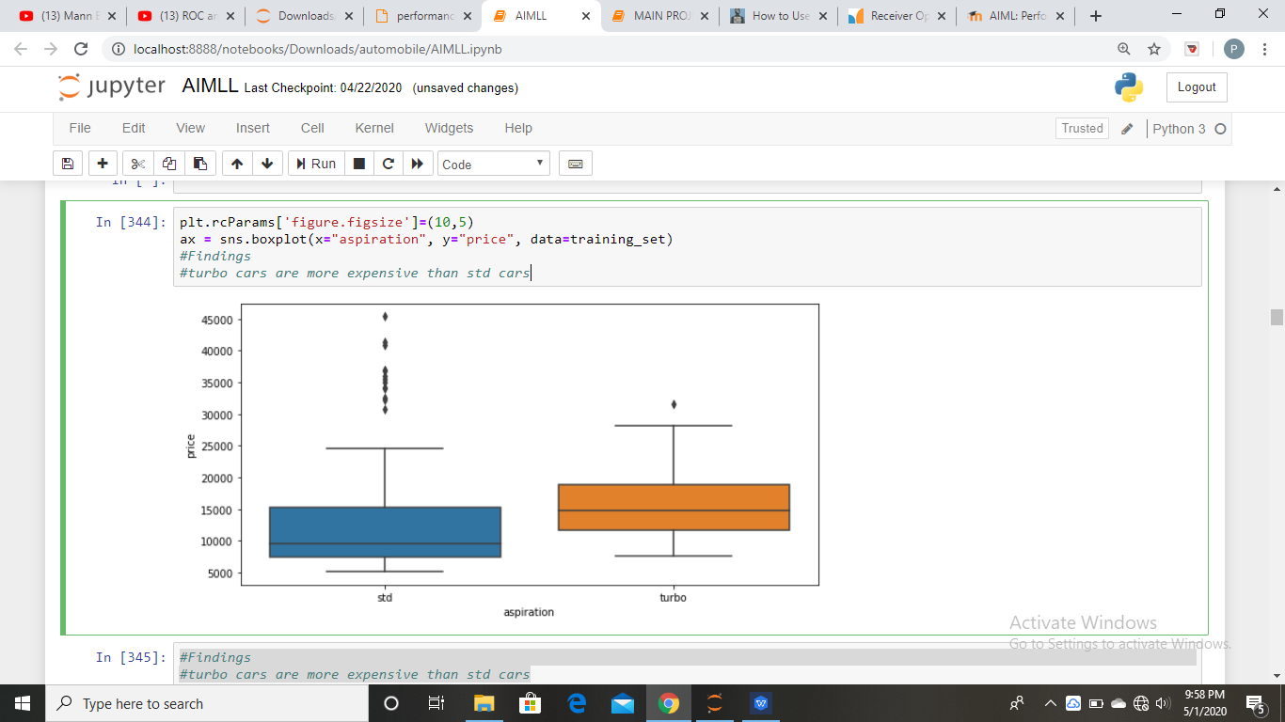
BOX PLOT

Slide 14
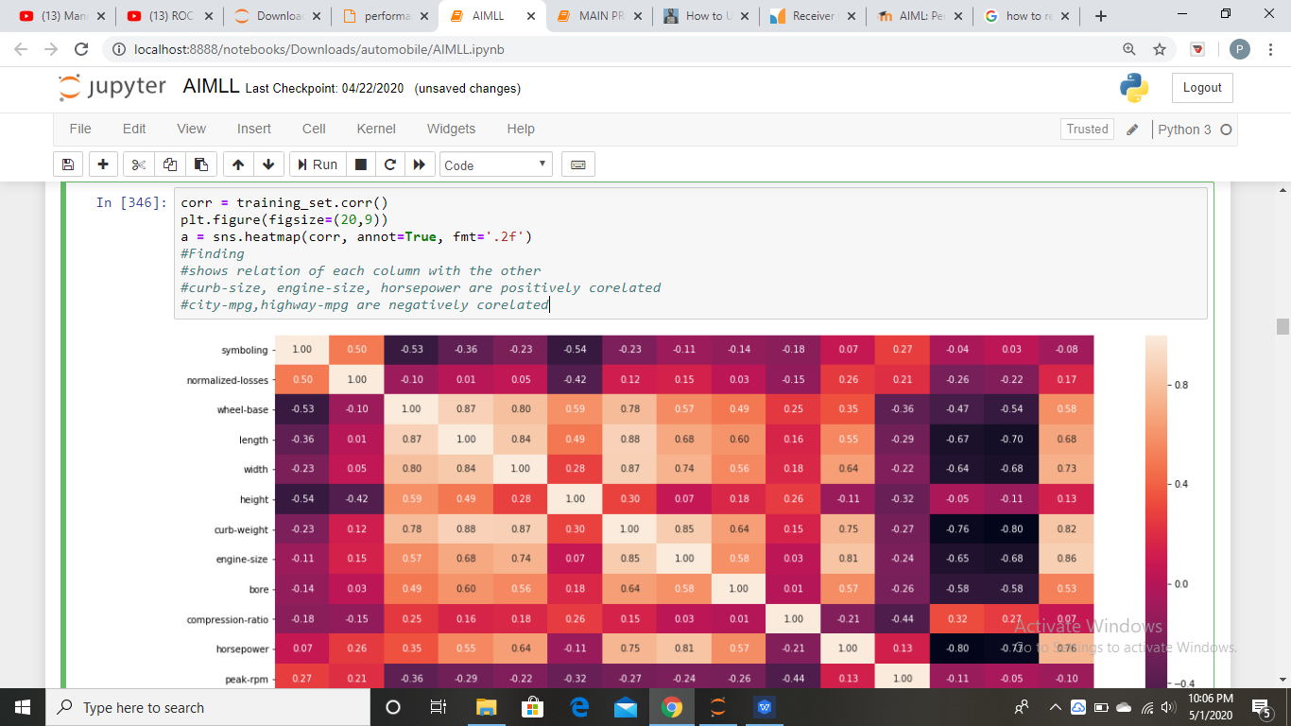
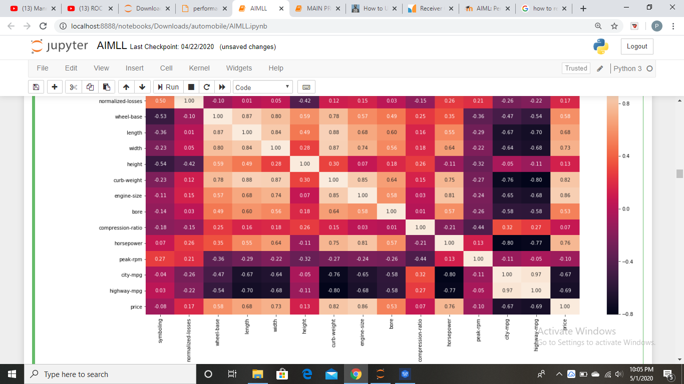
HEATMAP

Slide 15
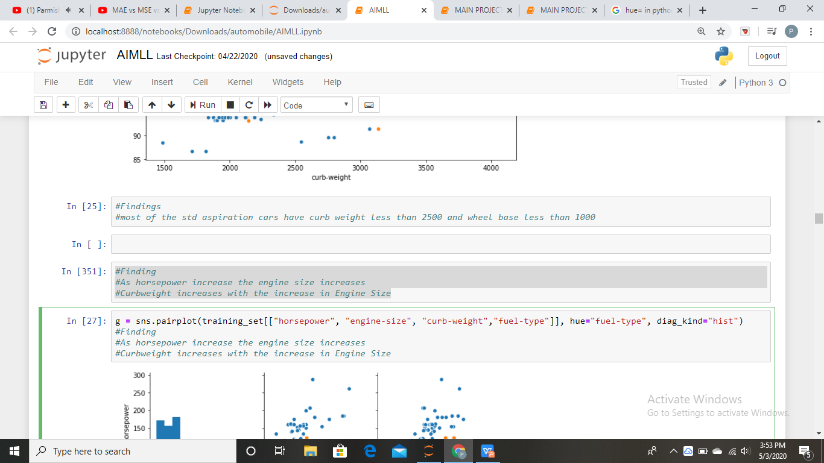
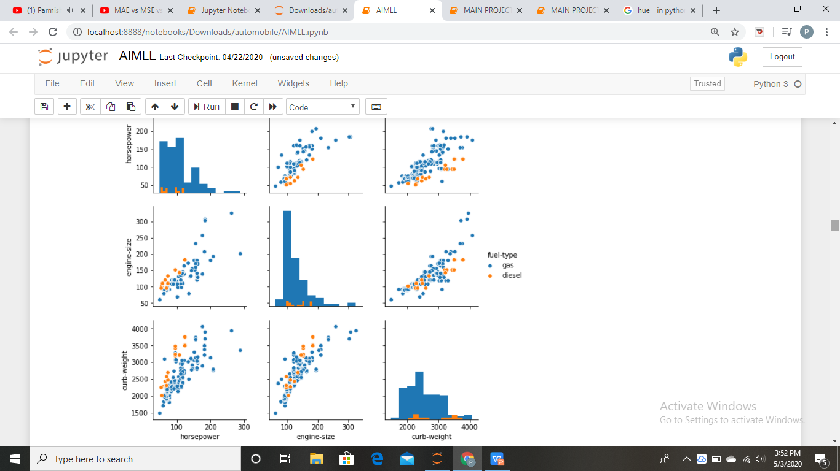
Pair plot

Slide 16
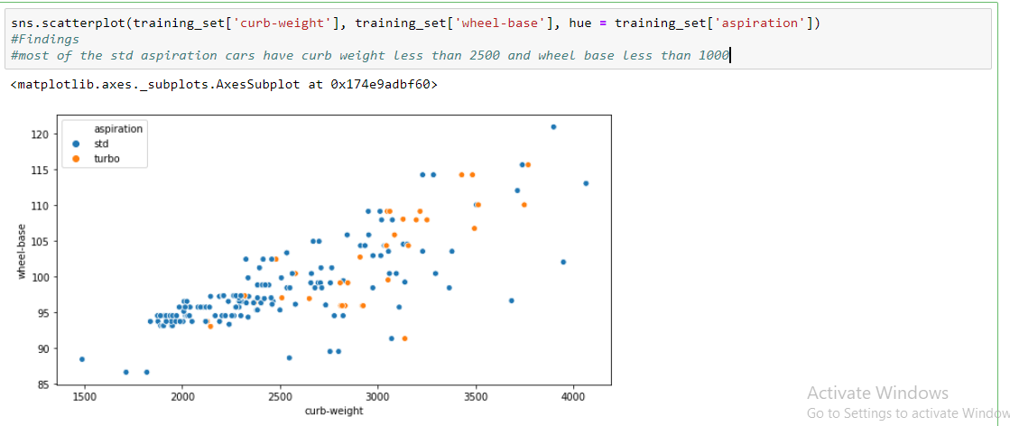
SCATTER PLOT

Slide 17
03.
REGRESSION
Linear regression, Polynomial regression, Logistic regression

Slide 18
TYPES OF REGRESSION
LINEAR REGRESSION
It is a linear approach to modeling the relationship between a scalar response (or dependent variable) and one or more explanatory variables (or independent variables).
POLYNOMIAL REGRESSION
The relationship between the independent variable x and dependent variable y is modeled as an nth degree polynomial
LOGISTIC REGRESSION
It is used to describe data and to explain the relationship between one dependent binary variable and one or more nominal, ordinal, interval or ratio-level independent variables.

Slide 19
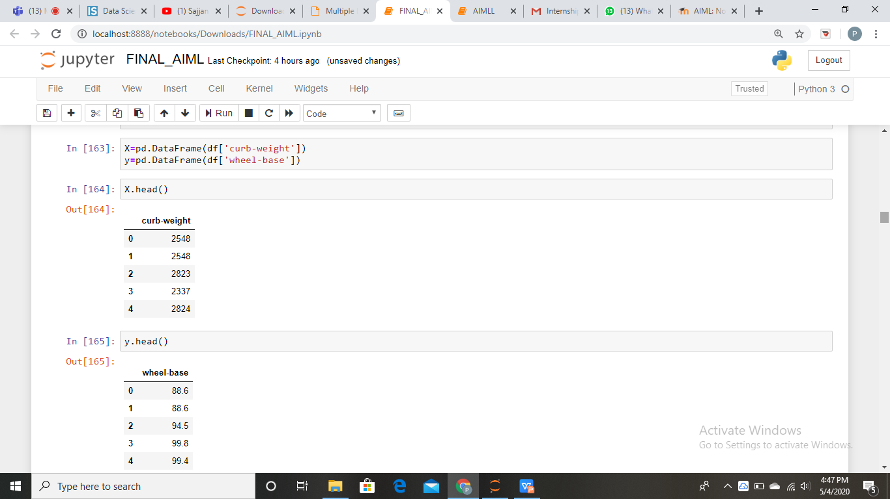
Selecting columns for performing regression

Slide 20
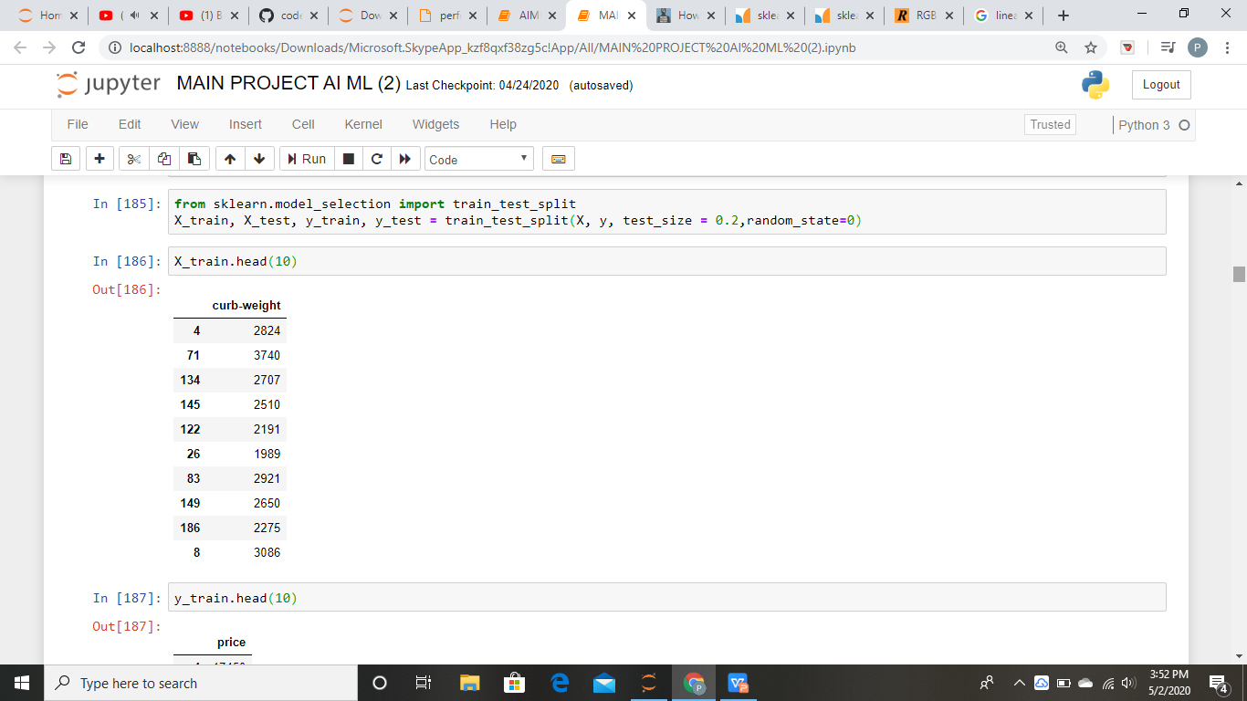
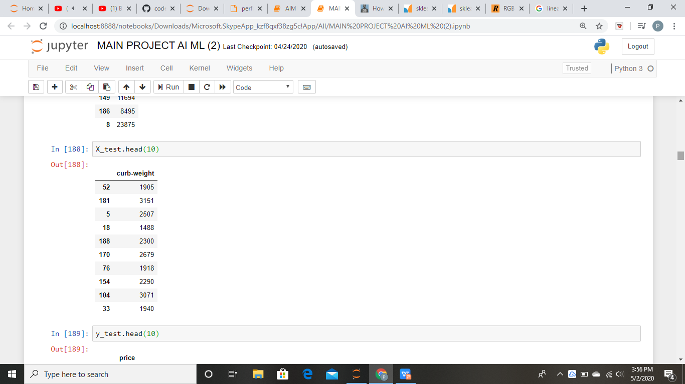
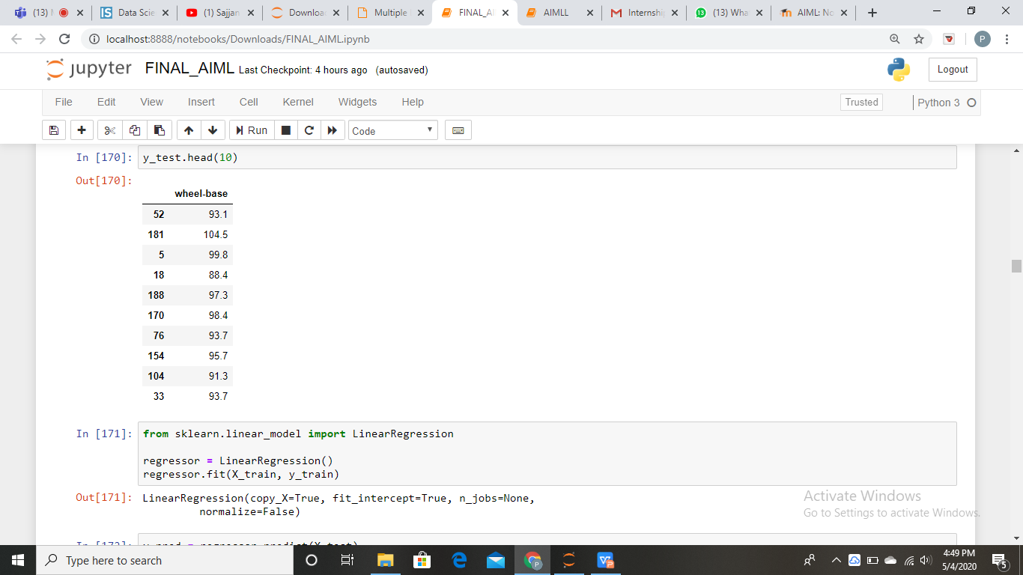
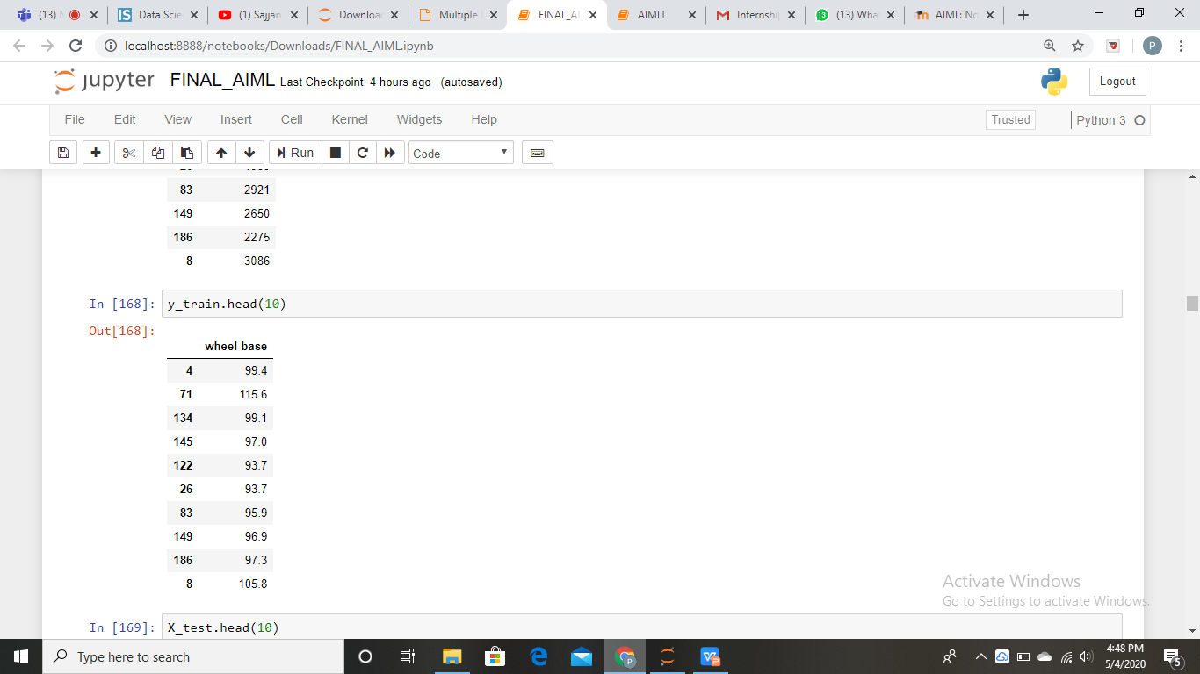
Splitting data

Slide 21
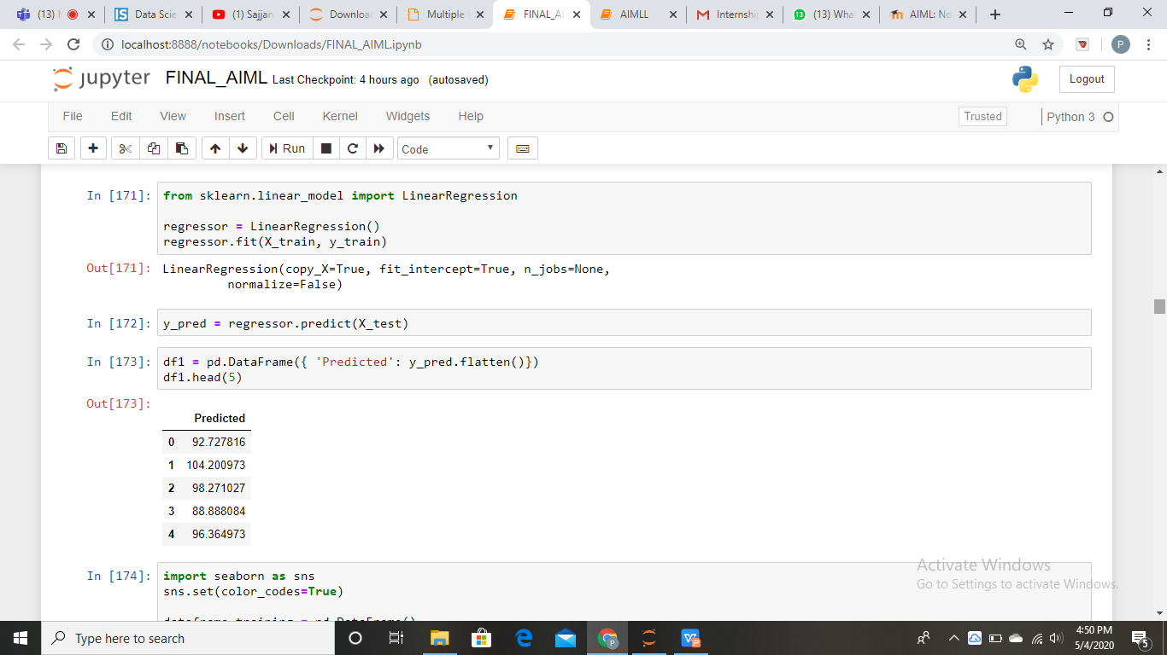
LINEAR REGRESSION

Slide 22
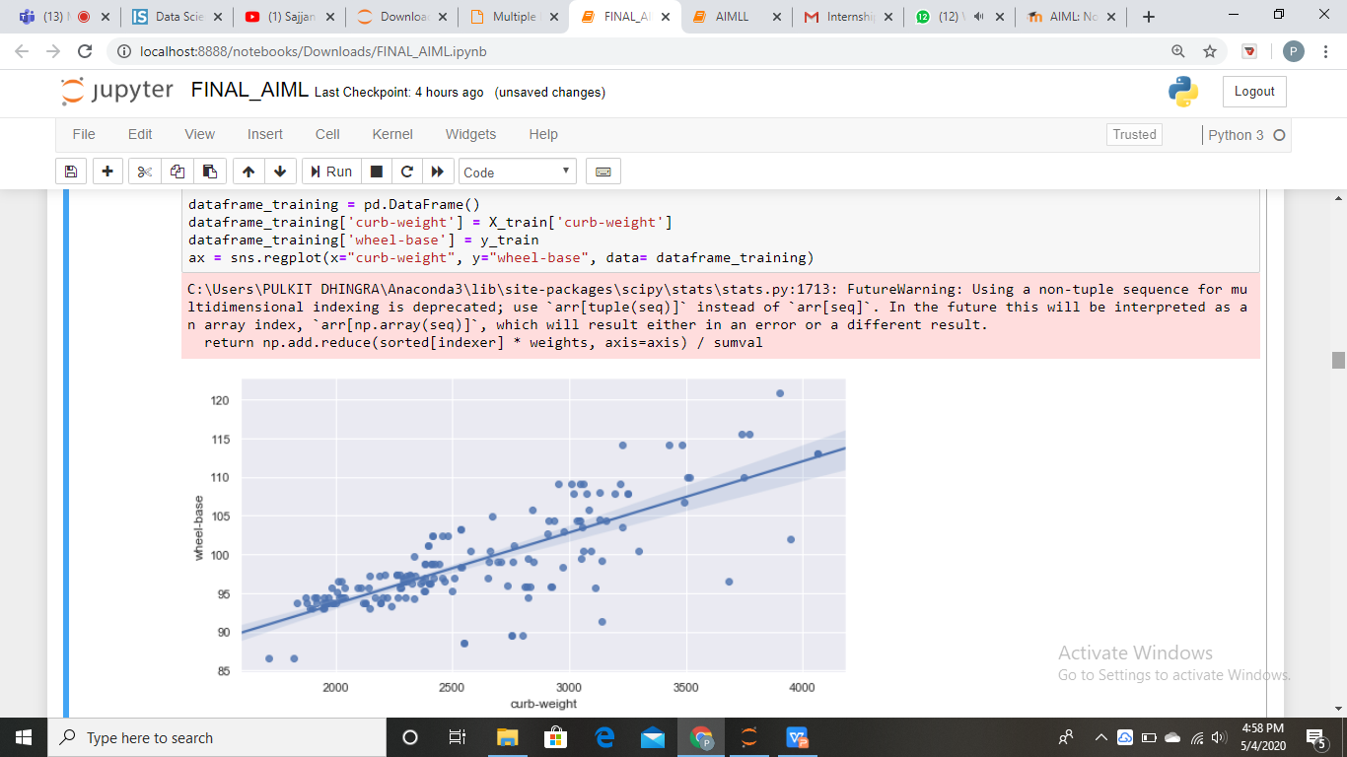
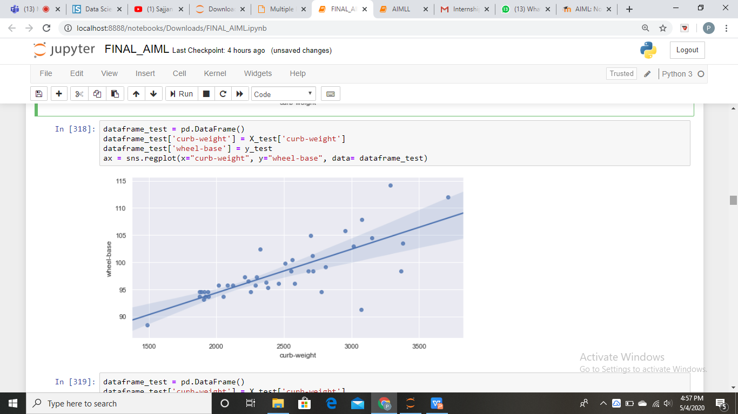
Plot for training and test data

Slide 23
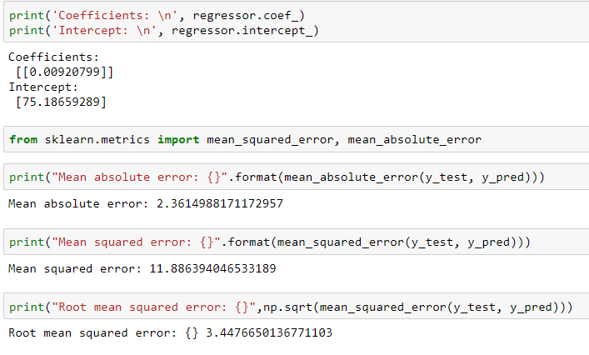
Errors and conclusions

Slide 24
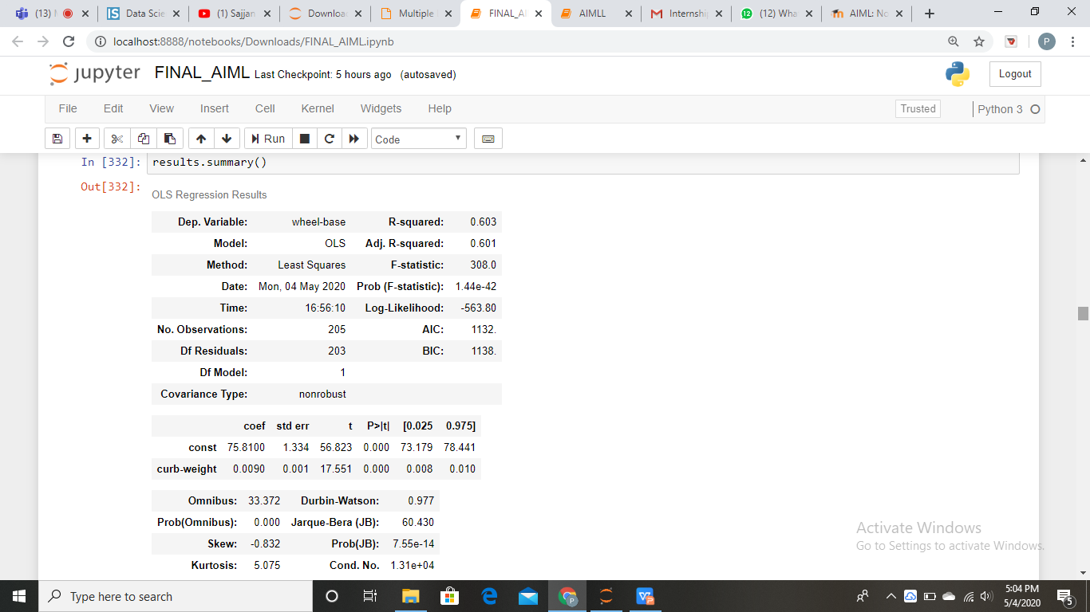
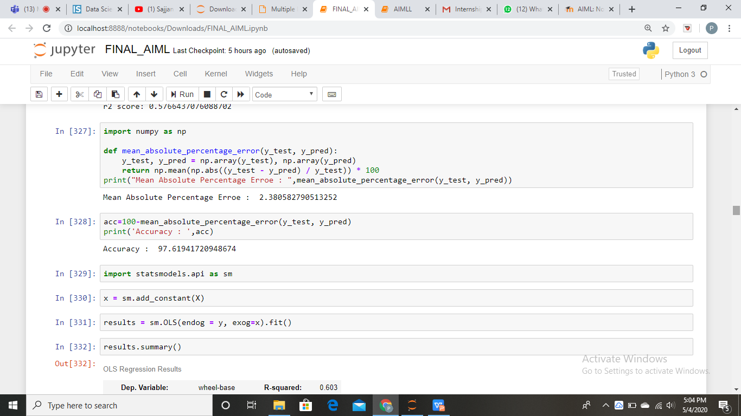

Slide 25
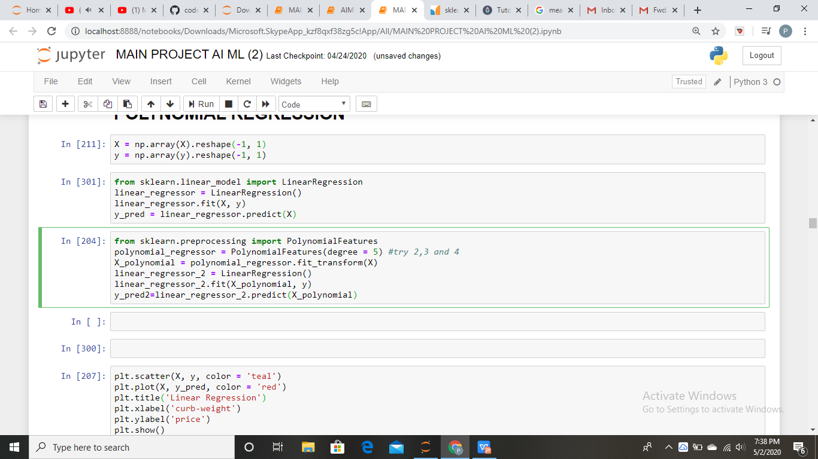
POLYNOMIAL REGRESSION

Slide 26
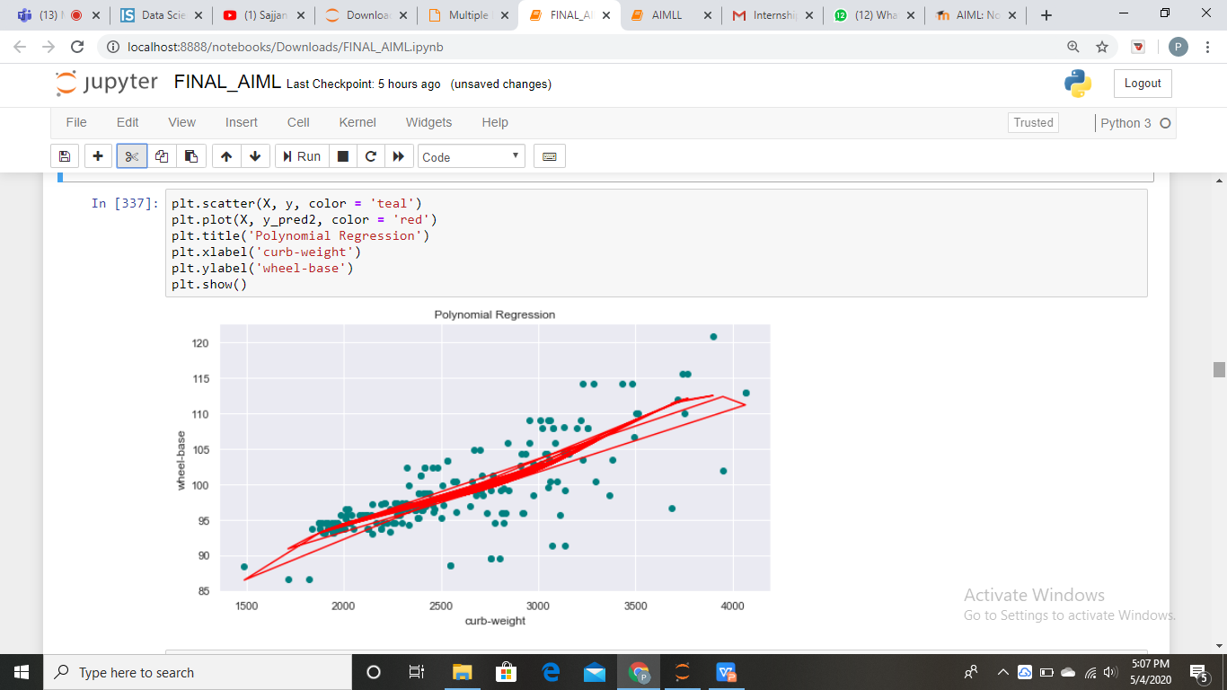
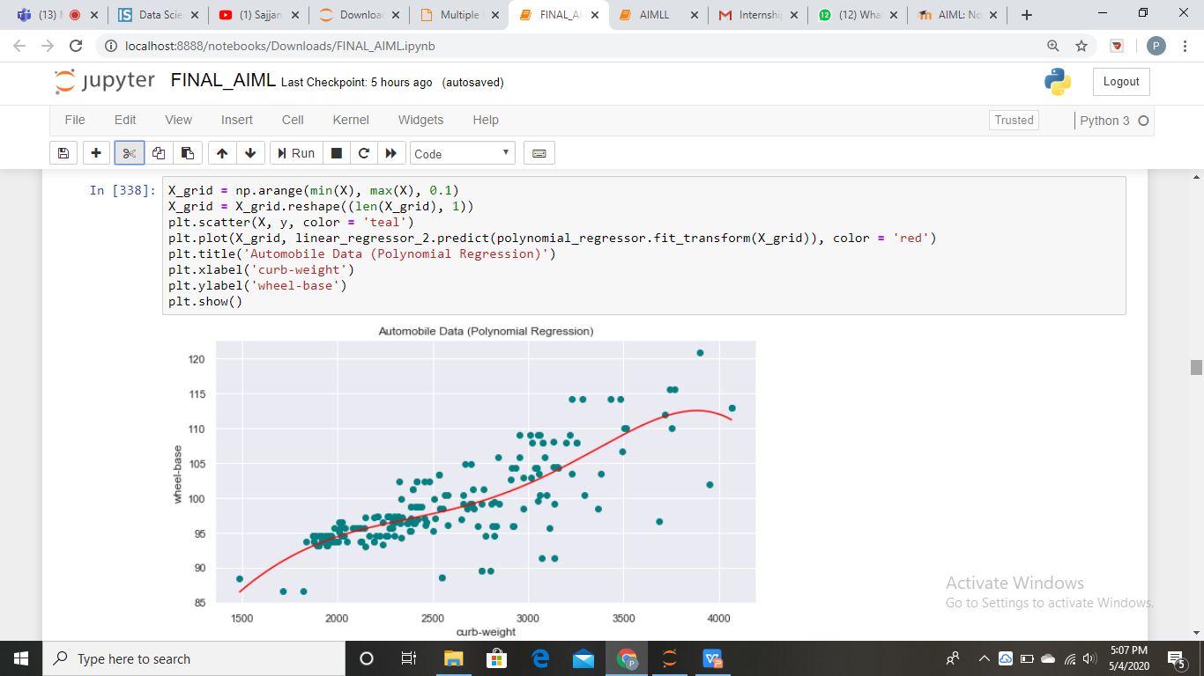
Graphs

Slide 27
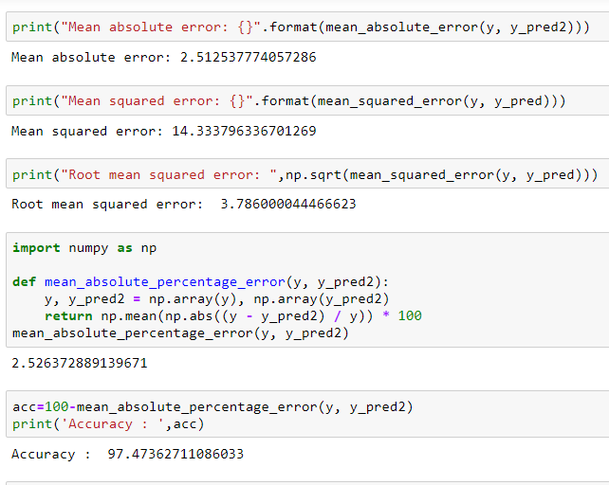
Errors and conclusions

Slide 28
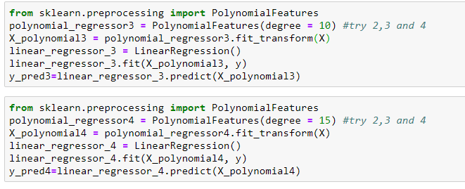
More models with different degrees

Slide 29
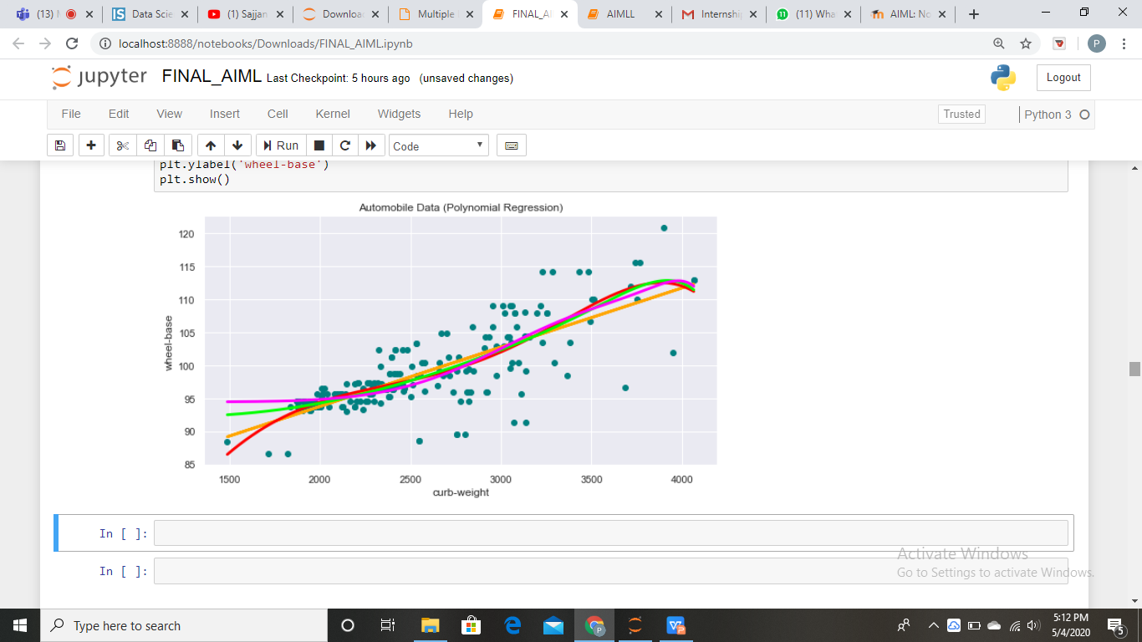
Comparision
Linear regg
Polynomial regg(degree5)
Polynomial regg (degree=10)
Polynomial regg(degree=15)

Slide 30
ACCURACY OF REGRESSIONS
POLYNOMIAL REGG.(DEGREE=5)
LINEAR REGRESSION
ACCURACY : 97.473
ACCURACY : 97.619
POLYNOMIAL REGG.(DEGREE=10)
POLYNOMIAL REGG.(DEGREE=15)
ACCURACY : 97.440
ACCURACY : 97.363

Slide 31
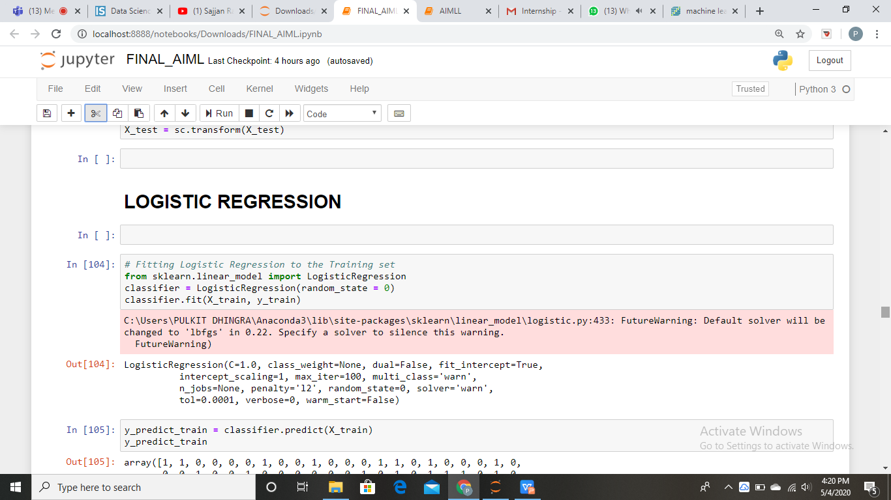
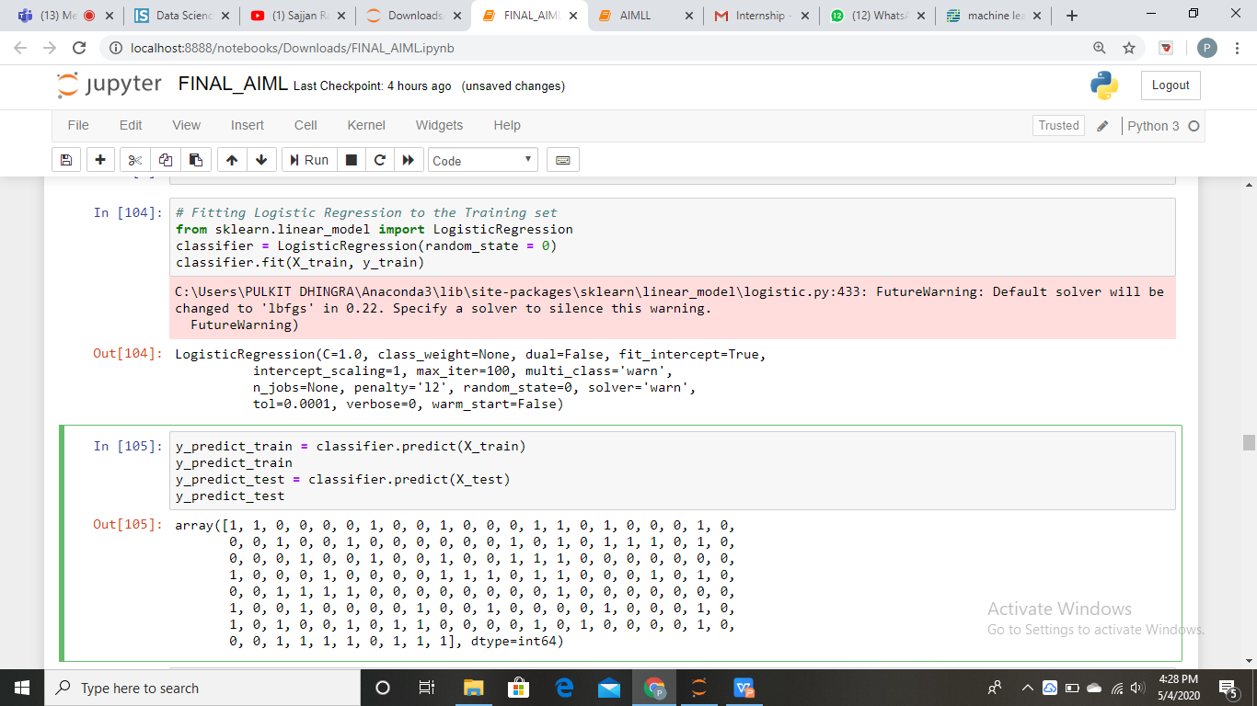
LOGISTIC REGRESSION

Slide 32
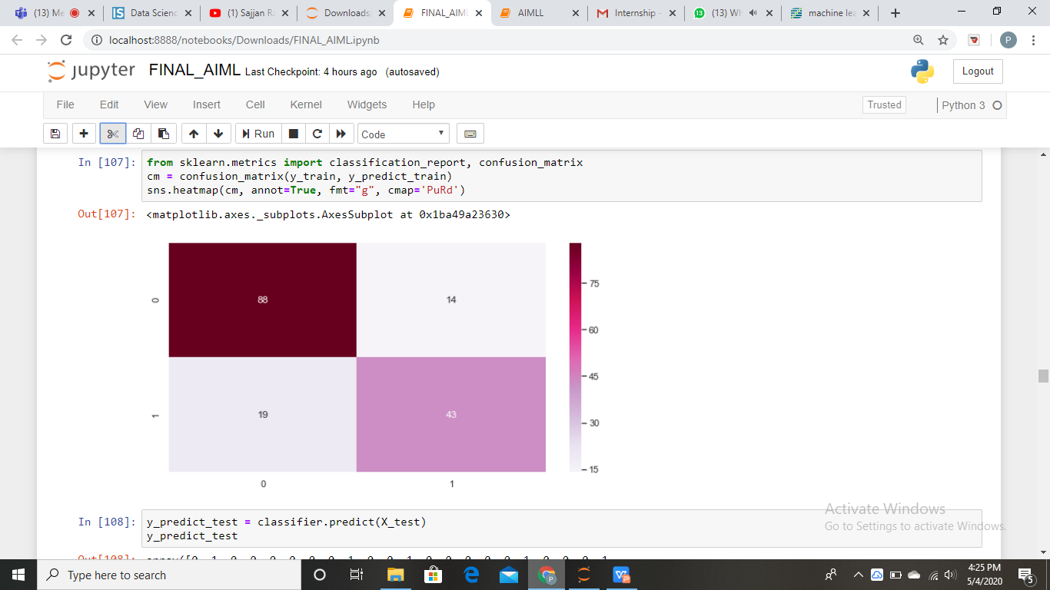
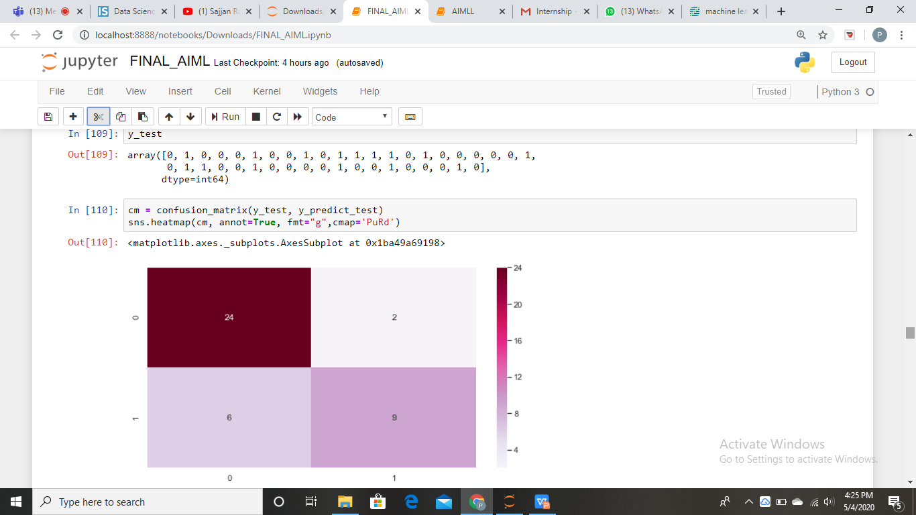
Confusion matrix
Training data
Test data

Slide 33
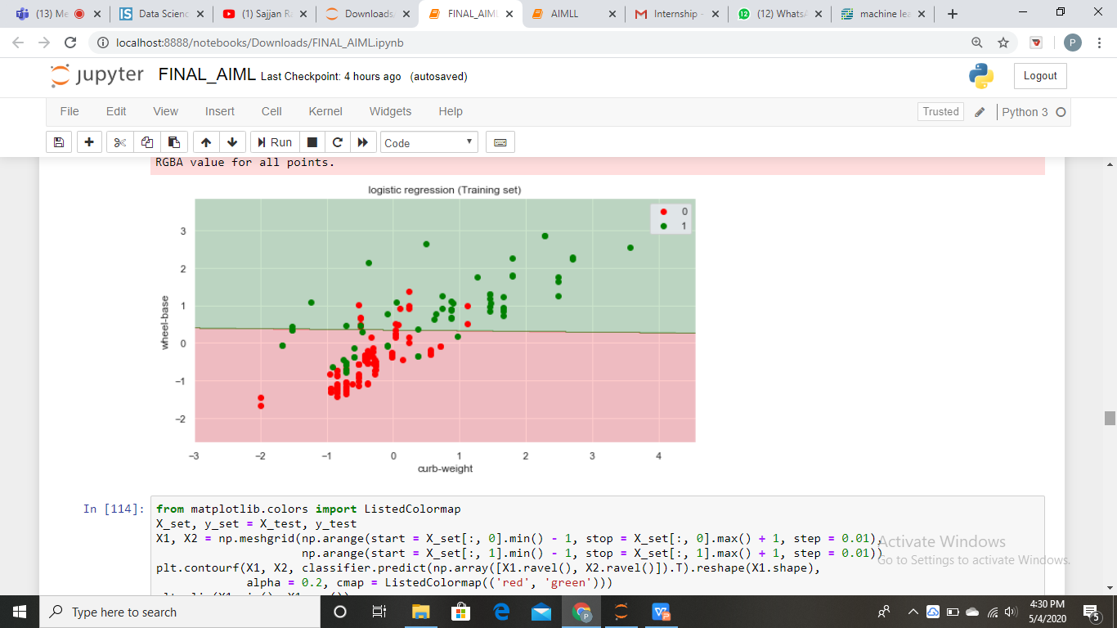
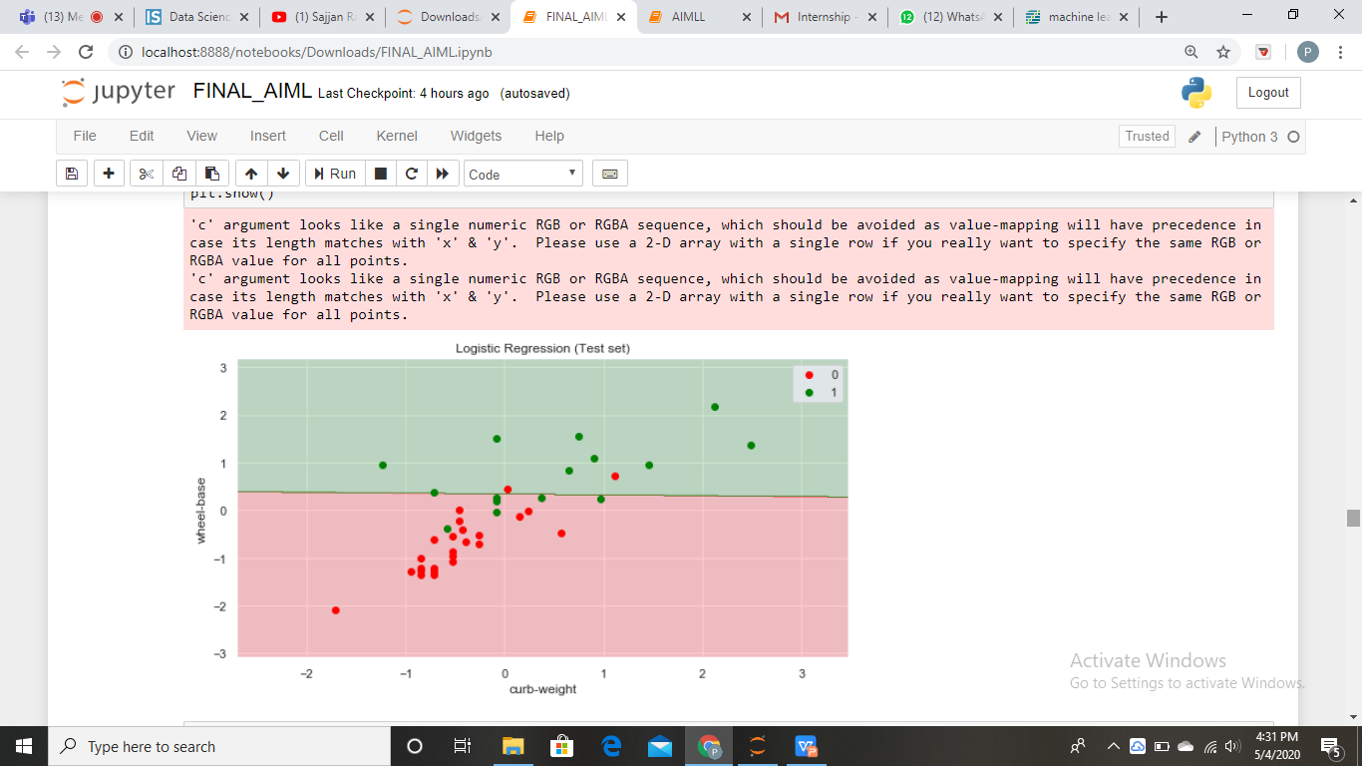
Plot for training and test data

Slide 34
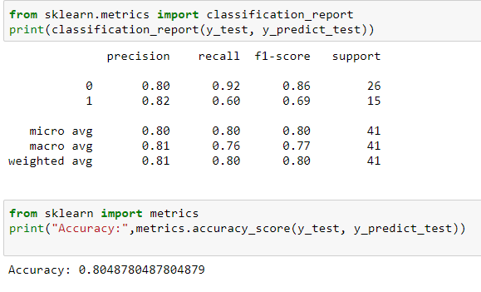
Accuracy

Slide 35
ACCURACY
Linear reg
Accuracy:97.619
Polynomial reg
Accuracy:97.473
Logistic reg
Accuracy:80.487
Maximun accuracy is of Linear Regression Model

Slide 36
04.
CLASSIFICATION
Types of clssification, decision tree, svm, knn, naive bayes, comparision

Slide 37
TYPES OF CLASSIFICATIONS
DECISION TREE
SVM
It builds classification models in the form of a tree structure.
We perform classification by finding the hyper-plane that differentiates the two classes very well
KNN
NAIVE BAYES
The new data point will be assigned a value based on how closely it matches the points in the training set.
It is based on Bayes' Theorem with an assumption of independence among predictors.

Slide 38
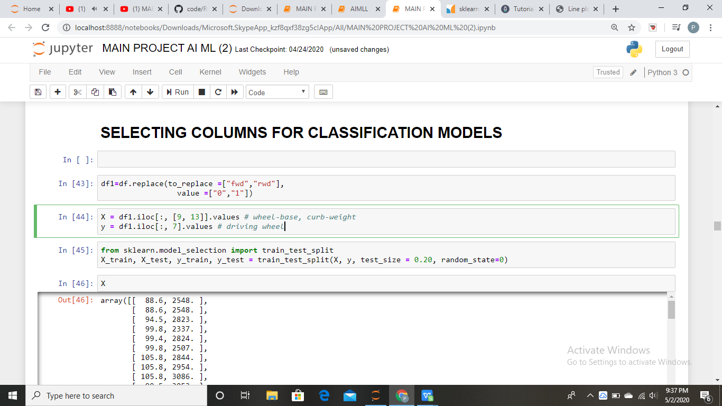
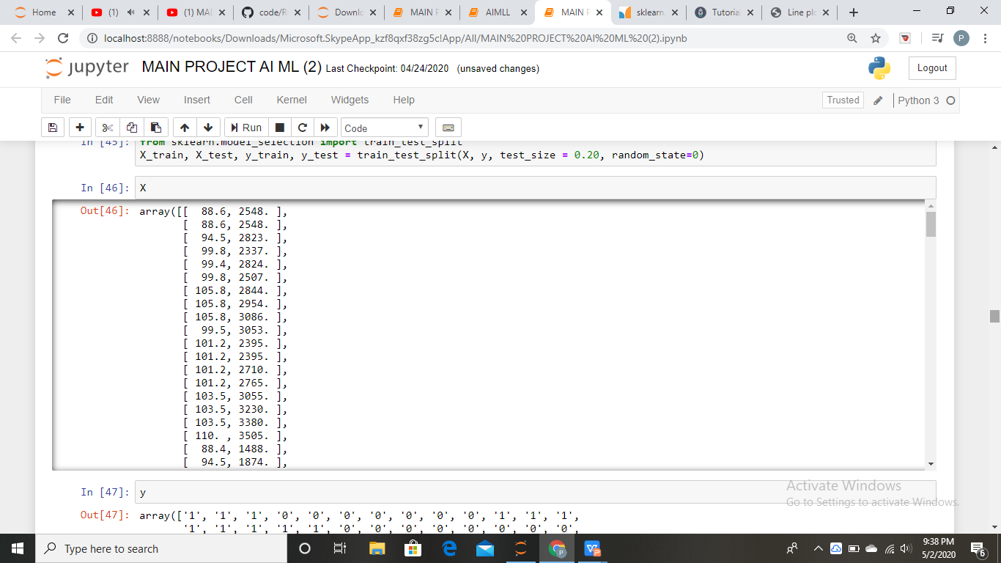
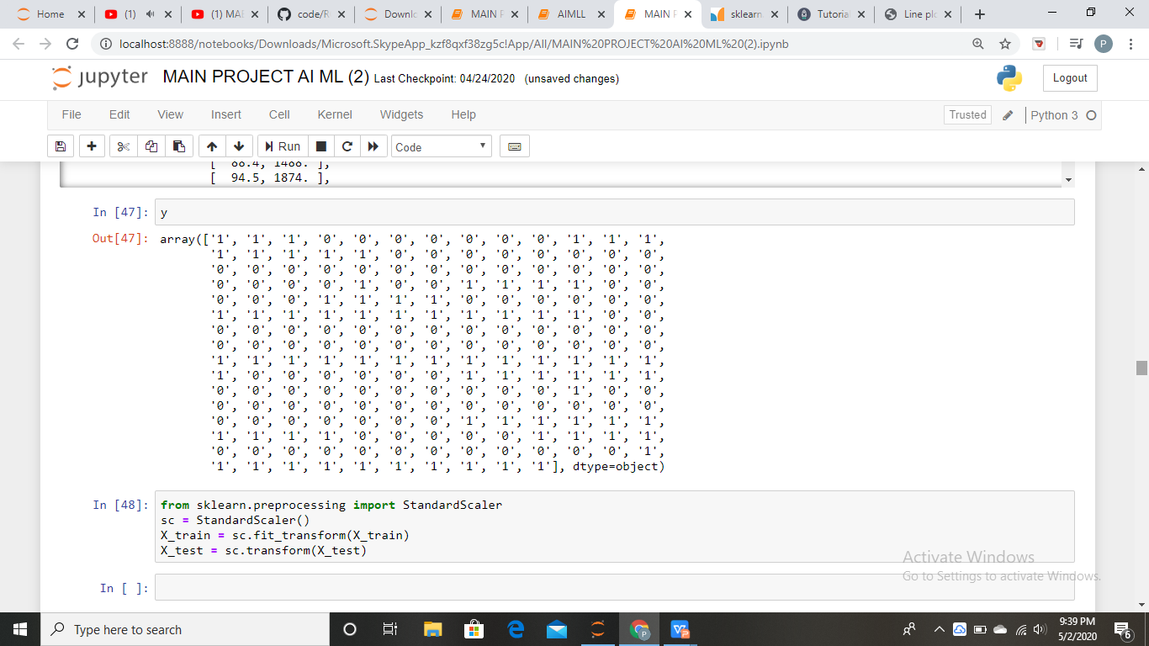
Selecting columns for classification

Slide 39
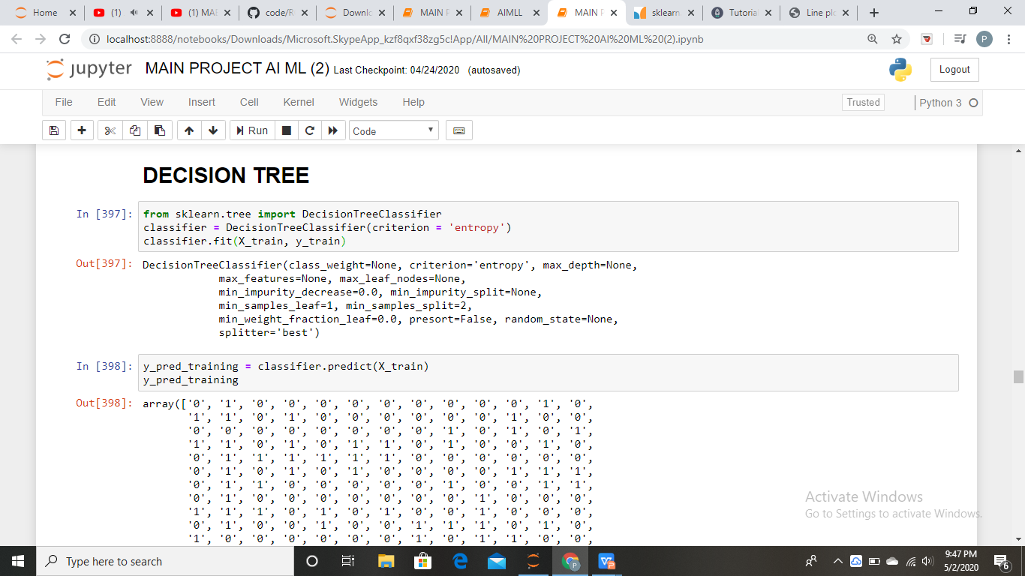
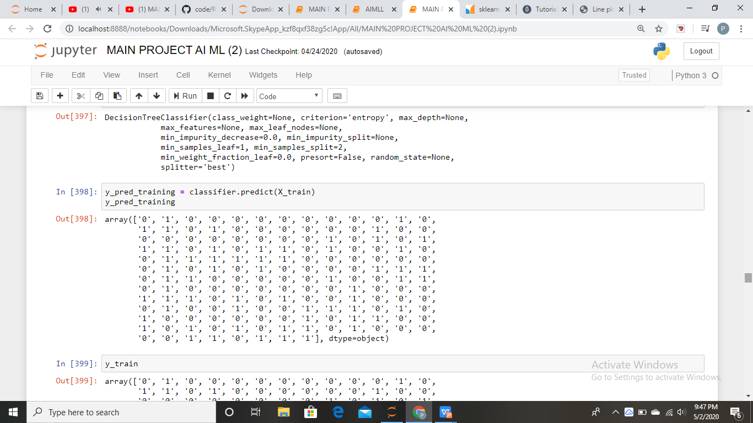
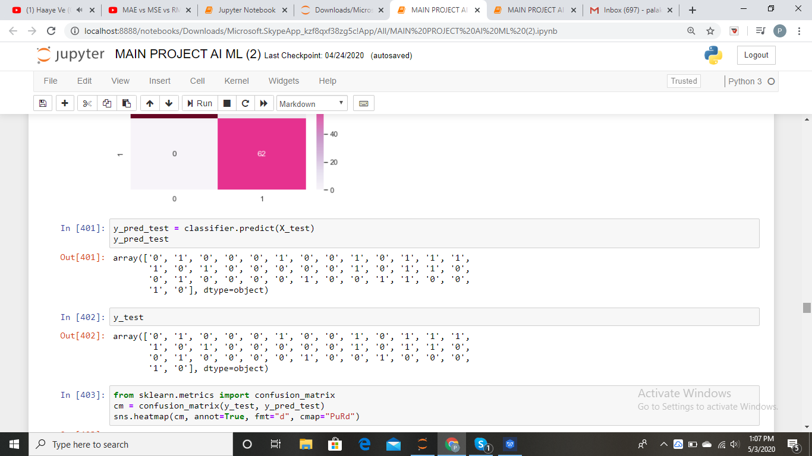
DECISION TREE

Slide 40
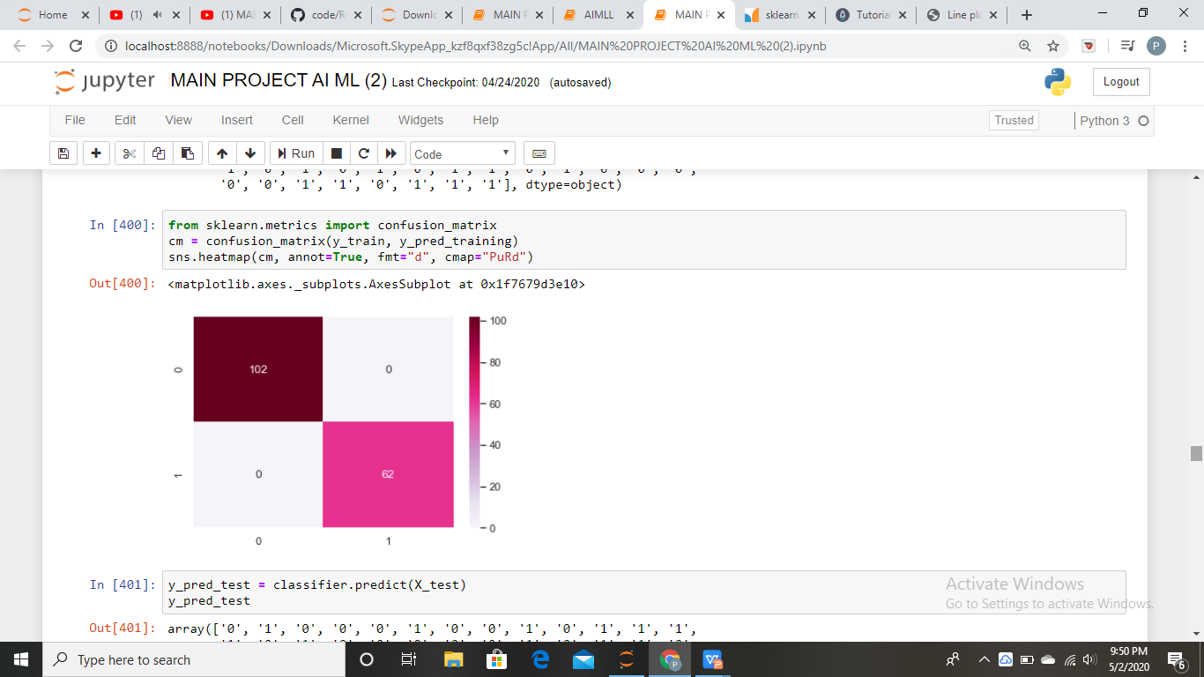
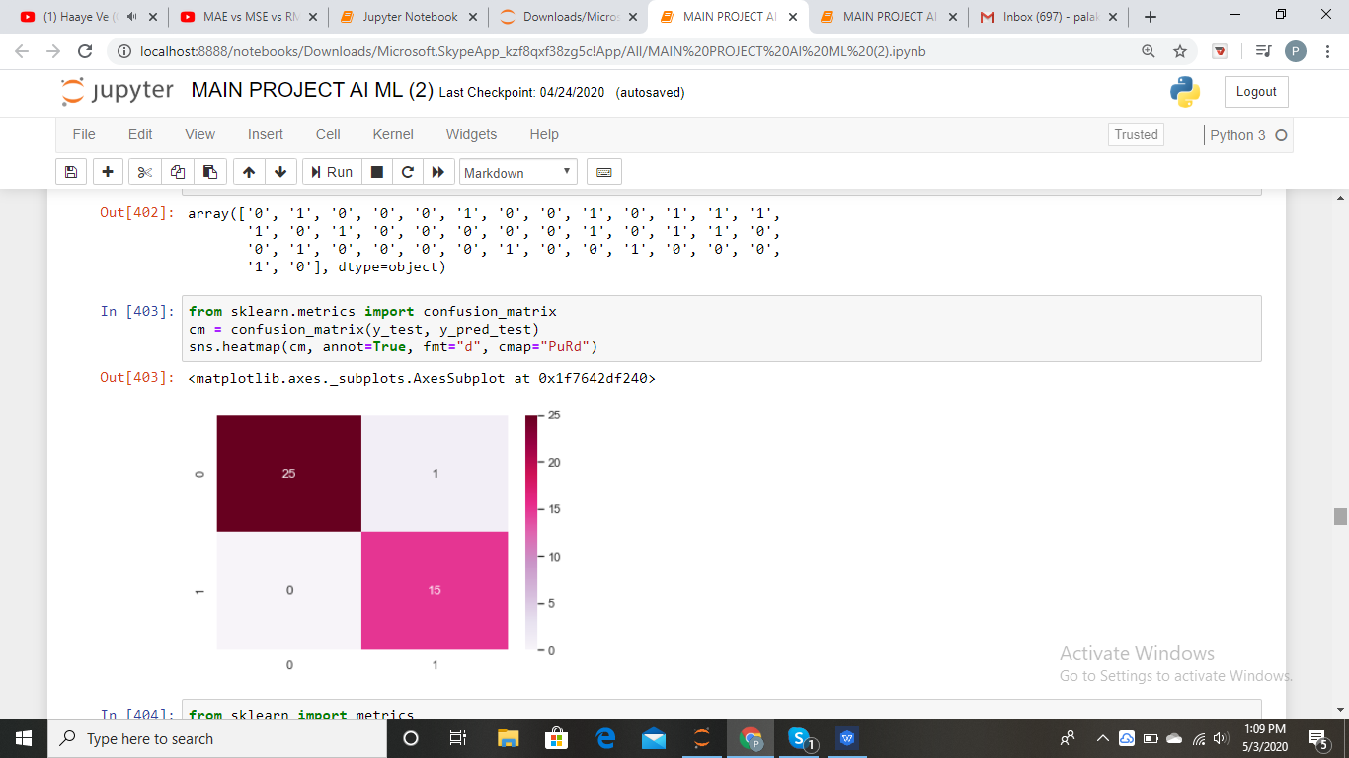
Confusion matrix
Training data
Test data

Slide 41
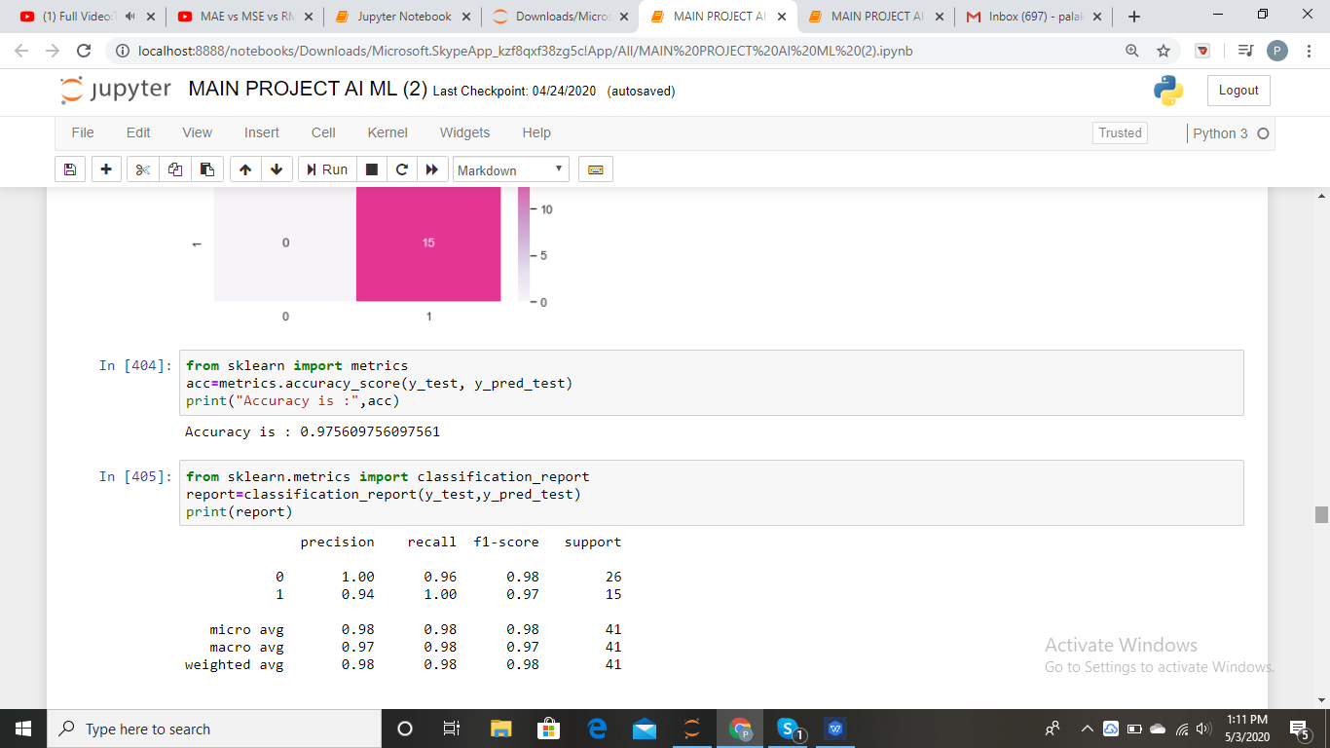
Accuracy measures

Slide 42
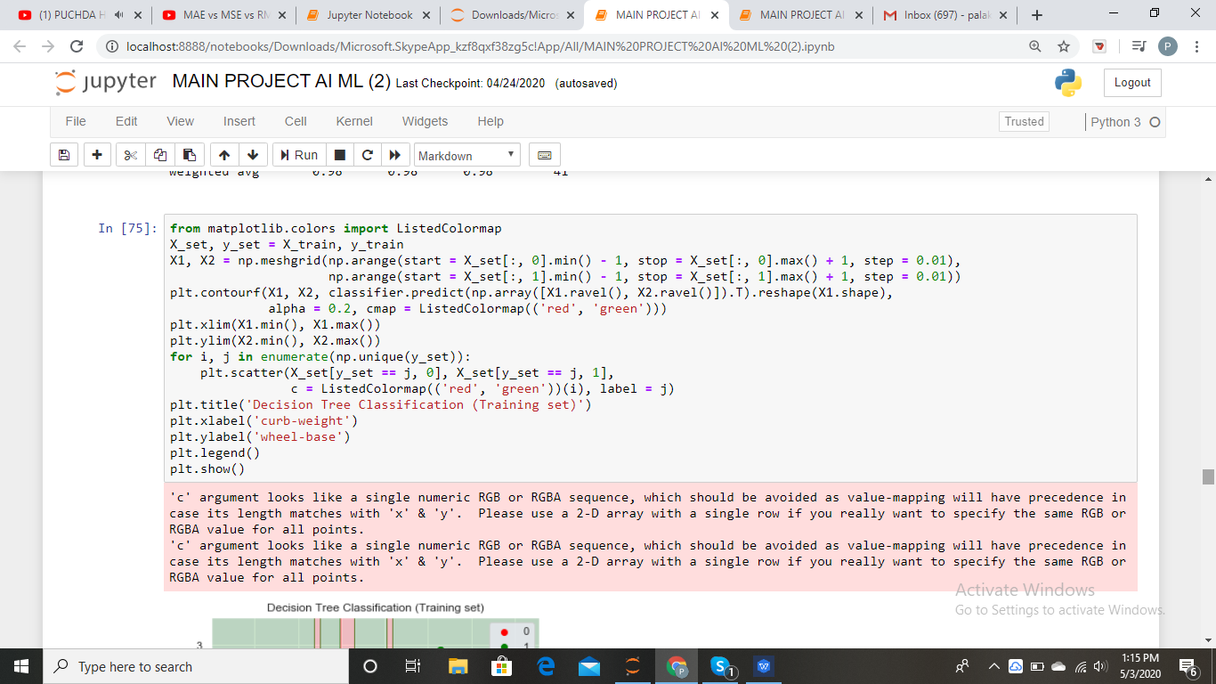

Plot for training data

Slide 43


Plot for test data

Slide 44



SVM

Slide 45


Confusion matrix
Training data
Test data

Slide 46

Accuracy measures

Slide 47


Plot for training data

Slide 48


Plot for test data

Slide 49



KNN ALGORITHM

Slide 50


Confusion matrix
Training data
Test data

Slide 51

Accuracy measures

Slide 52


Plot for training data

Slide 53


Plot for test data

Slide 54


Naive bayes

Slide 55


Confusion matrix
Training data
Test data

Slide 56

Accuracy measures

Slide 57


Plot fot training data

Slide 58


Plot for test data

Slide 59
ACCURACY OF CLASSIFICATION
DECISION TREE
SVM
ACCURACY : 97.560%
ACCURACY : 80.487%
KNN
NAIVE BAYES
ACCURACY : 78.048%
ACCURACY : 82.926%
Maximun accuracy is of Decision Tree Model

Slide 60
THANK YOU

